Slide 1
CLI Application Tractography selection and measurements
Fan Zhang, Sonia Pujol,
Lauren J. O'Donnell
Brigham and Women’s Hospital
Harvard Medical School
Notes:
Hello everyone, my name is Fan from BWH. I am going to present a tutorial about fiber bundle selection and scalar measurement. It is about how to do further processing after we obtain tractography.

Slide 2
Learning Objectives
Following this tutorial, you’ll be able to conduct the fiber bundle selection and calculate fiber tract scalar measurement in command line interface (CLI) mode.
Notes:
In this tutorial, I’ll introduce how to do some after-tractography processing. The first one is how to select fiber tracts passing through a region of interest. For example, given a label map of CC, we want to see the fibers passing through the CC. The second one is to calculate scalar measurements from the the selected fiber bundles. Like, how to compute the mean FA from the tracts of the CC.

Slide 3
CLI
CLI is standalone executable with a limited input/output arguments complexity (simple argument types, no user interactions).
Applying CLI can be efficient when there are a large amount of data to process, for example of conducting patient/control group study.
Notes:
In this tutorial, I’ll introduce how to do some after-tractography processing. The first one is how to select fiber tracts passing through a region of interest. For example, given a label map of CC, we want to see the fibers passing through the CC. The second one is to calculate scalar measurements from the the selected fiber bundles. Like, how to compute the mean FA from the tracts of the CC.

Slide 4
Pre-requisite
This tutorial is a follow-up tutorial of:
Diffusion MRI analysis http://dmri.slicer.org/docs/tutorials/DiffusionMRIanalysis.pdf
Fiber Bundle Selection and Scalar Measurementshttp://dmri.slicer.org/docs/tutorials/FiberBundleSelectionAndScalarMeasurement.pdf
Please go through them ahead.
Notes:
This is a follow-up tutorial of the DTI tutorial by Sonia. A brief introduction, the DTI tutorial introduces how to do tensor estimation to obtain DTI, how to calculate the scalar tensor measurement such as FA, Trace from DTI, and how to do tractography.

Slide 5
3D Slicer
The tutorial uses the 3D Slicer (Version 4.8.1, revision 26813, Stable Release) software available at:
http://download.slicer.org
Disclaimer
It is the responsibility of the user of 3DSlicer to comply with both the terms of the license and with the applicable laws, regulations and rules. Slicer is a tool for research, and is not FDA approved.

Slide 6
SlicerDMRI
An open-source project to improve and extend diffusion magnetic resonance imaging software in 3D Slicer:
http://dmri.slicer.org
Follow the “Diffusion MRI Analysis” to install SlicerDMRI :
http://dmri.slicer.org/docs/tutorials/DiffusionMRIanalysis.pdf
Notes:
This is a follow-up tutorial of the DTI tutorial by Sonia. A brief introduction, the DTI tutorial introduces how to do tensor estimation to obtain DTI, how to calculate the scalar tensor measurement such as FA, Trace from DTI, and how to do tractography.

Slide 7
Tutorial Data
Download sample data, at http://www.na-mic.org/Wiki/images/6/66/Cli_data.zip
The tutorial uses 5 datasets (cases 1 to 5, included in the Cli_data.zip), in which:
Case 1 is from the neurosurgery tutorial dataset, downloaded from: https://www.slicer.org/slicerWiki/images/b/bb/WhiteMatterExplorationData.zip
Case 2 is from the diffusion MRI tutorial dataset, downloaded from: https://www.slicer.org/slicerWiki/images/e/e6/Dti_tutorial_data.zip
Cases 3 to 5 are from the Human Connectome Project (HCP)*, download from: http://www.humanconnectome.org
For each case, the following data are provided:
Baseline image
Down sampled whole brain tractography (conducted as in the DWI tutorial and down-sampled to about 10000 fibers using Tractography Display module)
Corpus callosum label map (drawn as in the DWI tutorial)
*Data courtesy of the Human Connectome Project

Slide 8
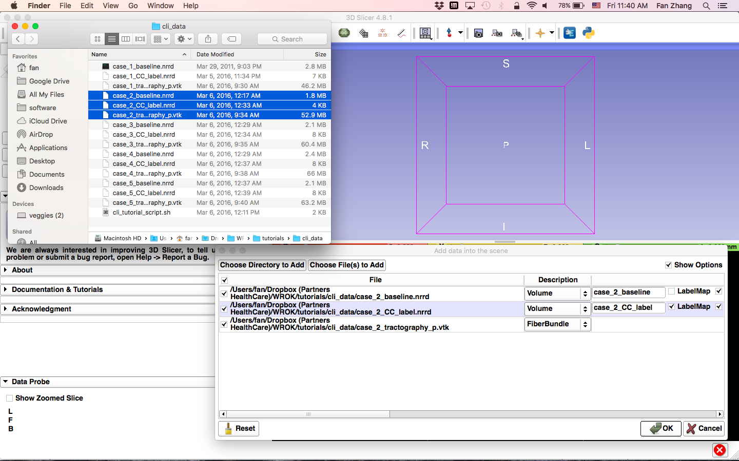
Data preview
Load all three files from case 2 in the folder where all datasets reside.
Drag and drop the file onto the viewer of the Slicer application
Load the tractography as FiberBundle
Click OK to load the dataset to Slicer
Please notice that the CLI operation is conducted outside 3D Slicer interface. The screenshots with 3D Slicer interface in this tutorial are used only for visualizing the data.
Notes:
First, let’s load a mrml file that includes the data we need in this tutorial.

Slide 9
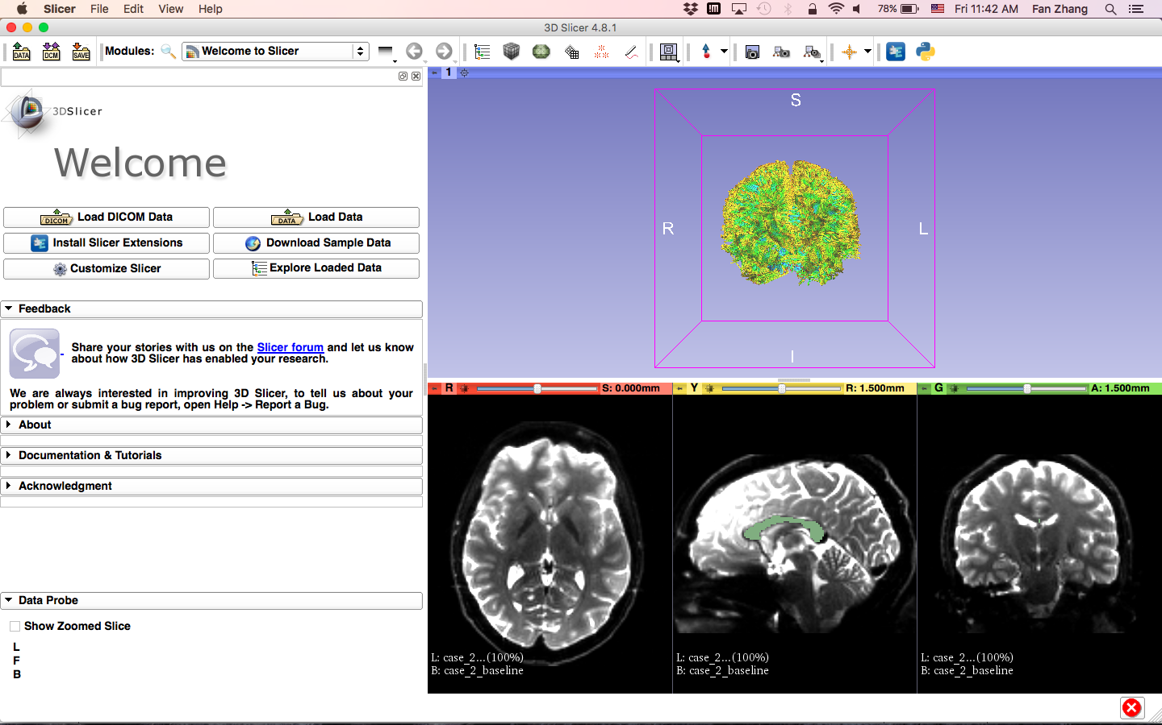
Data preview
Data loaded from case 2, including:
Whole brain tractography
Baseline image
Corpus callosum (CC) mask
Load other cases for preview
Notes:
First, let’s load a mrml file that includes the data we need in this tutorial.

Slide 10
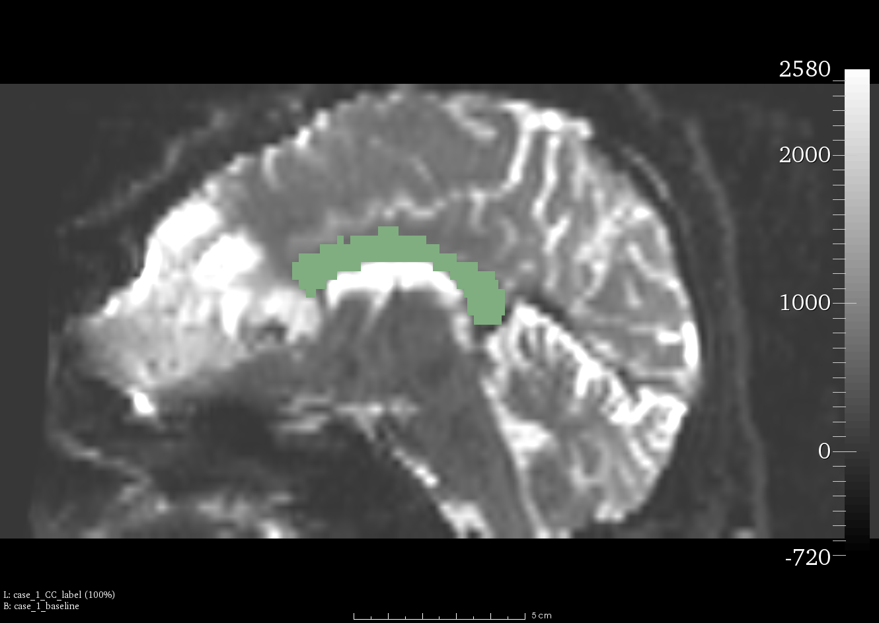
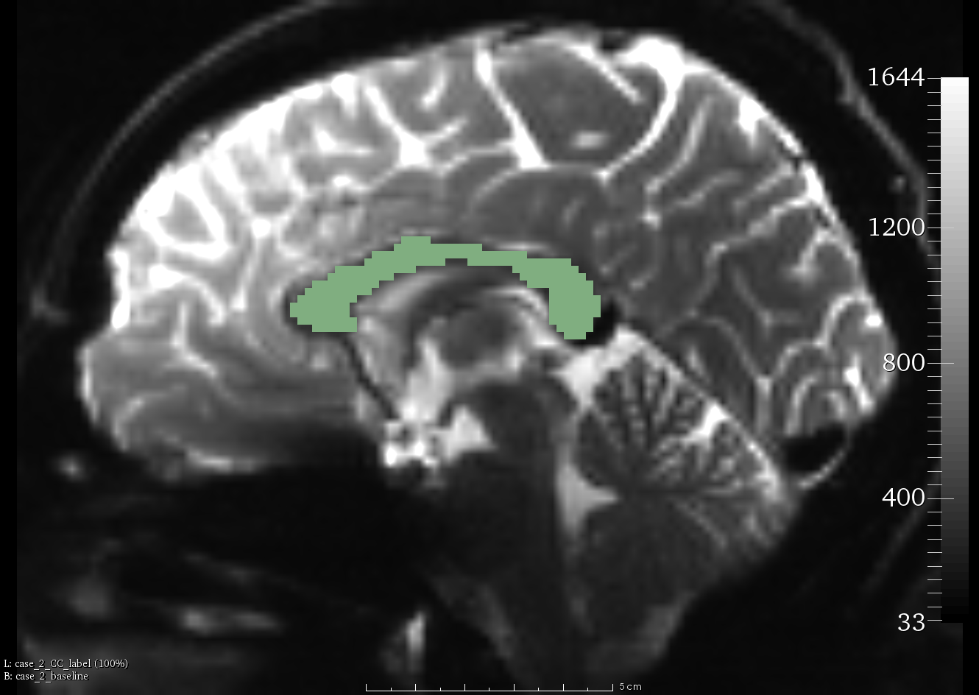
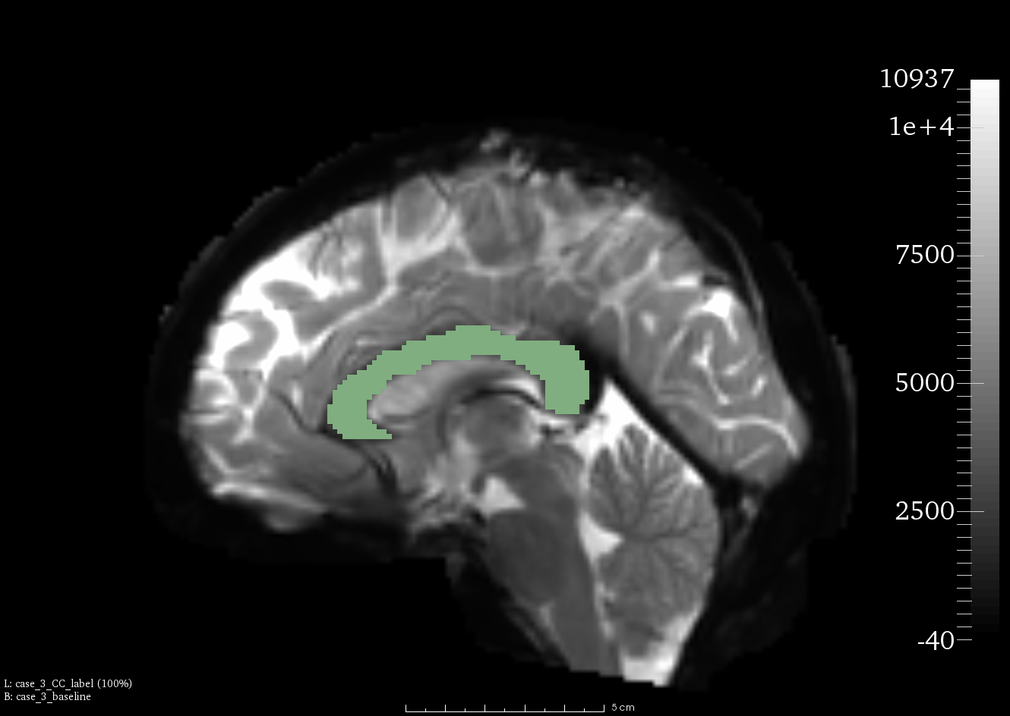
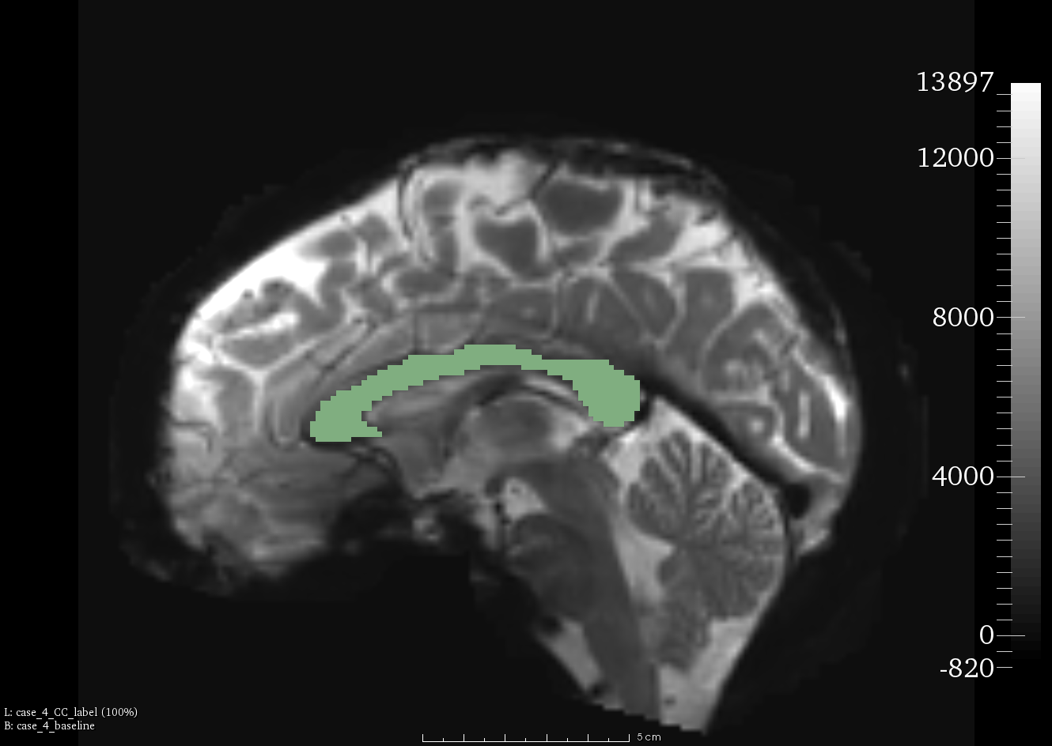
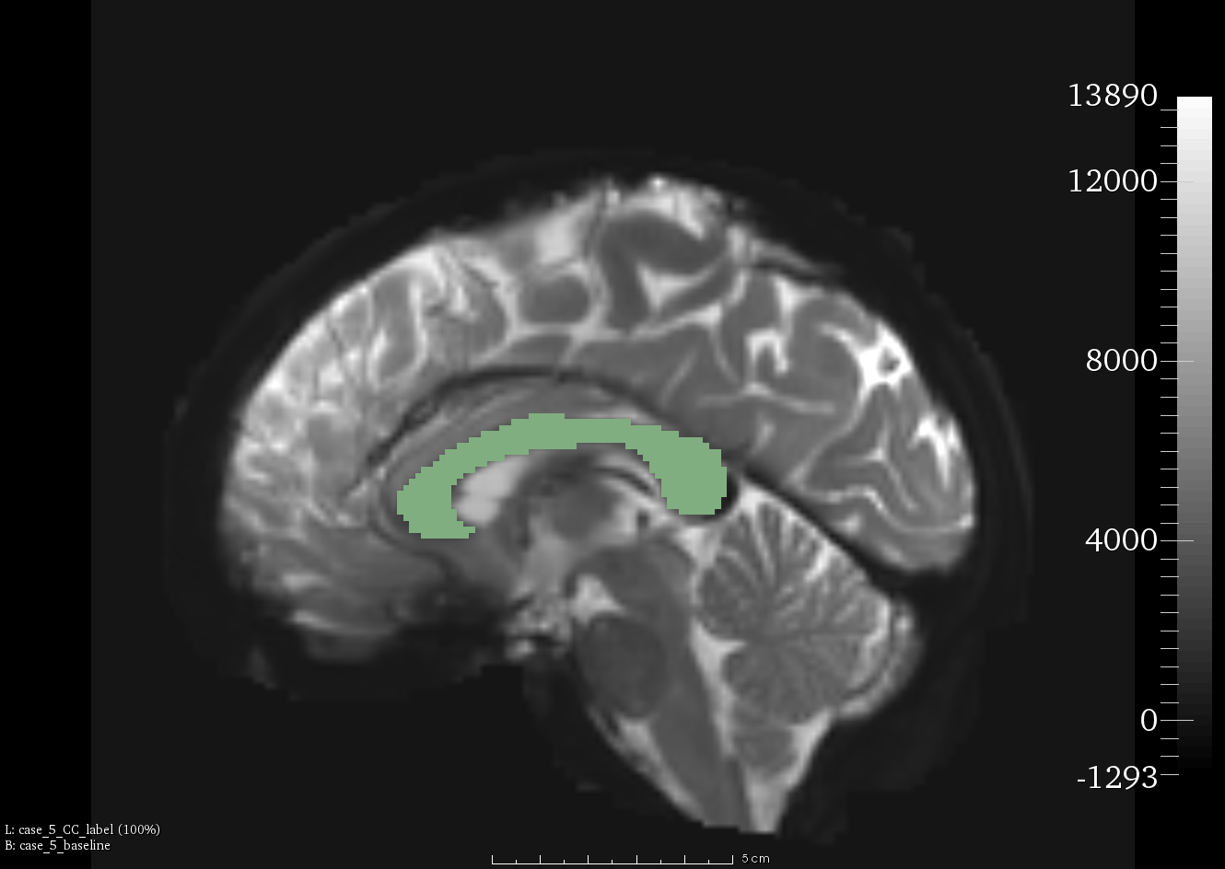
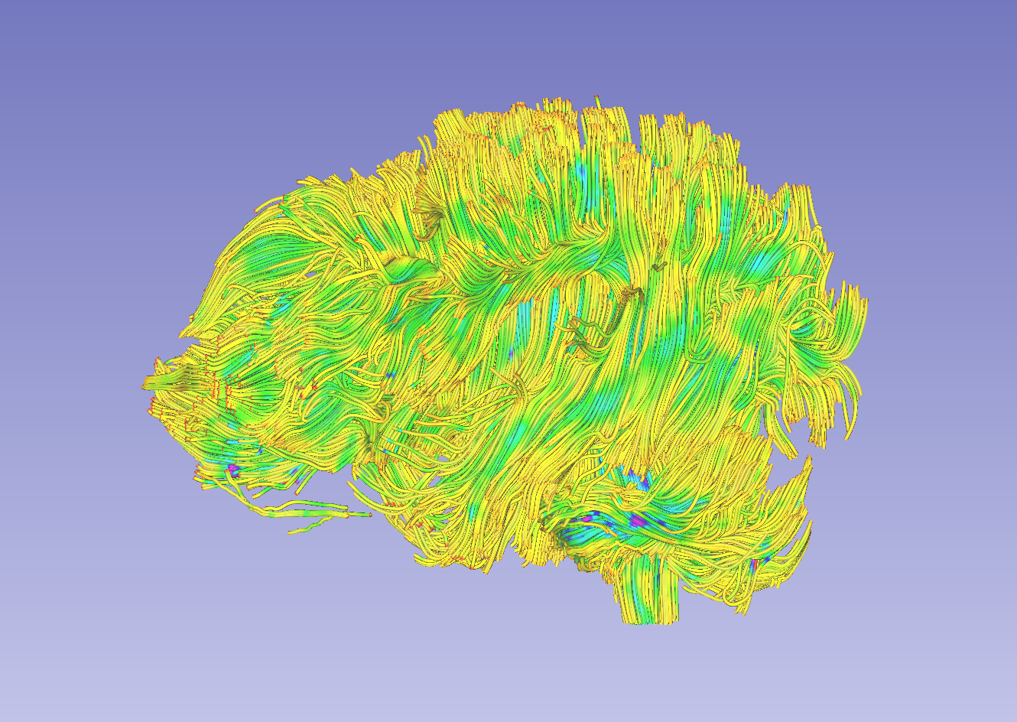
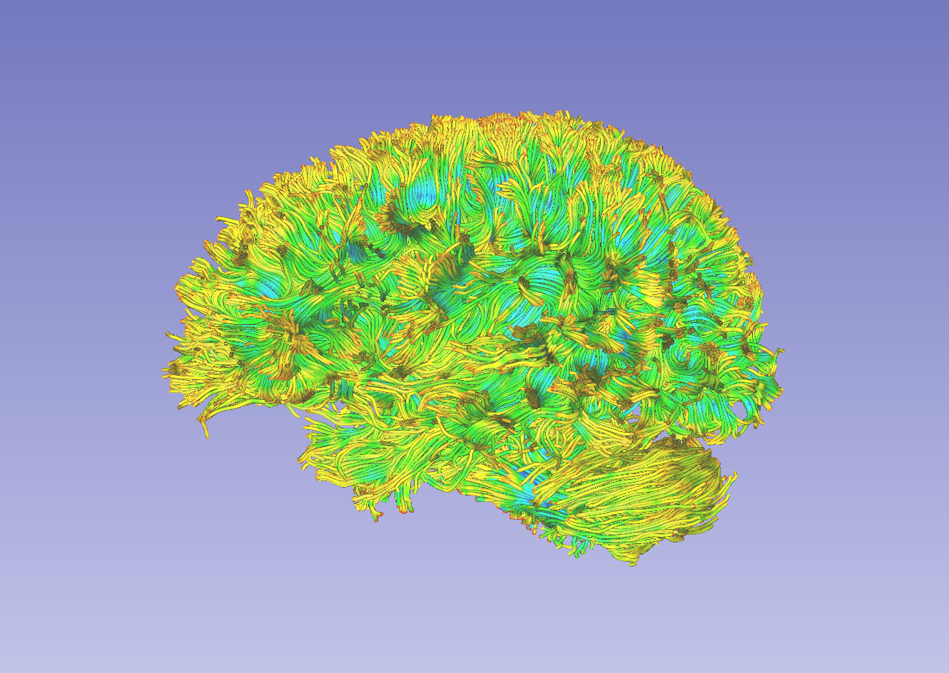
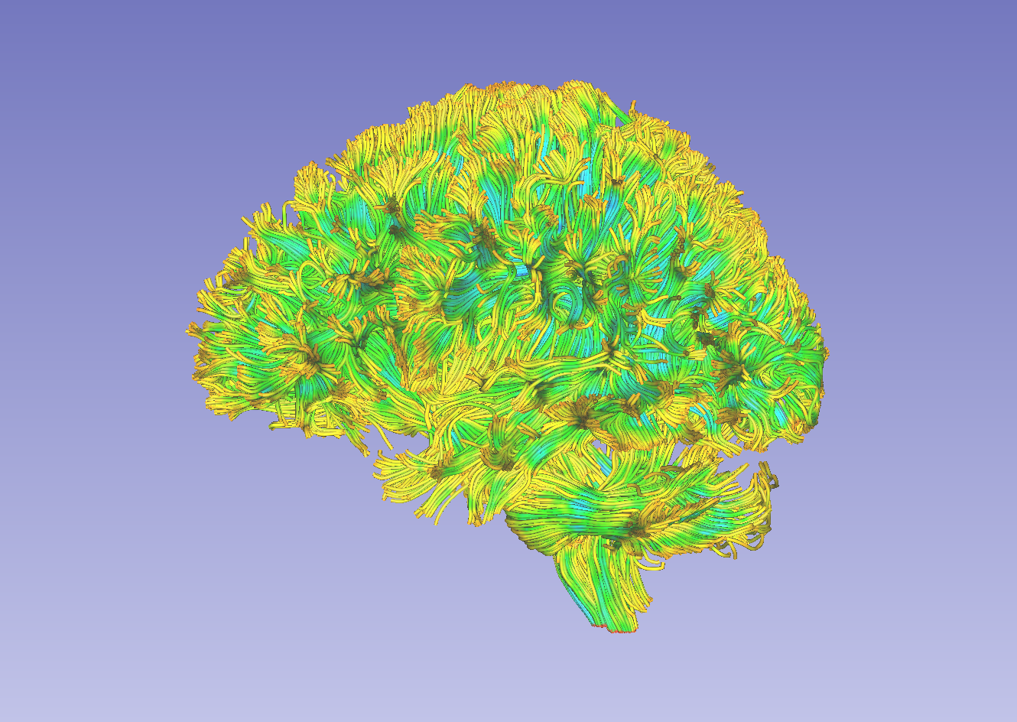
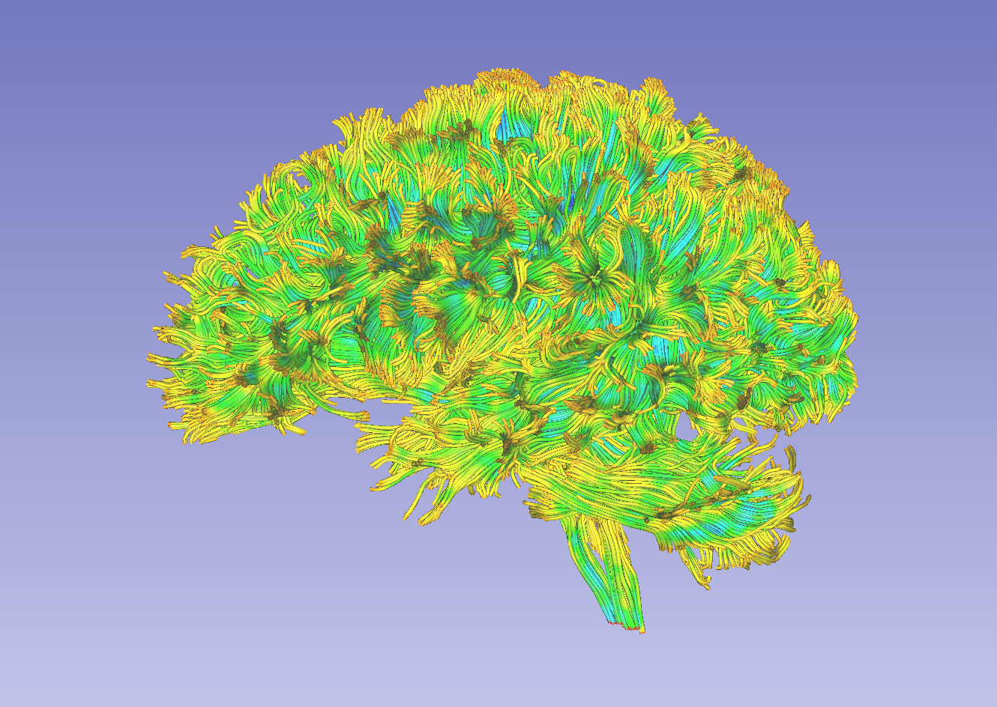
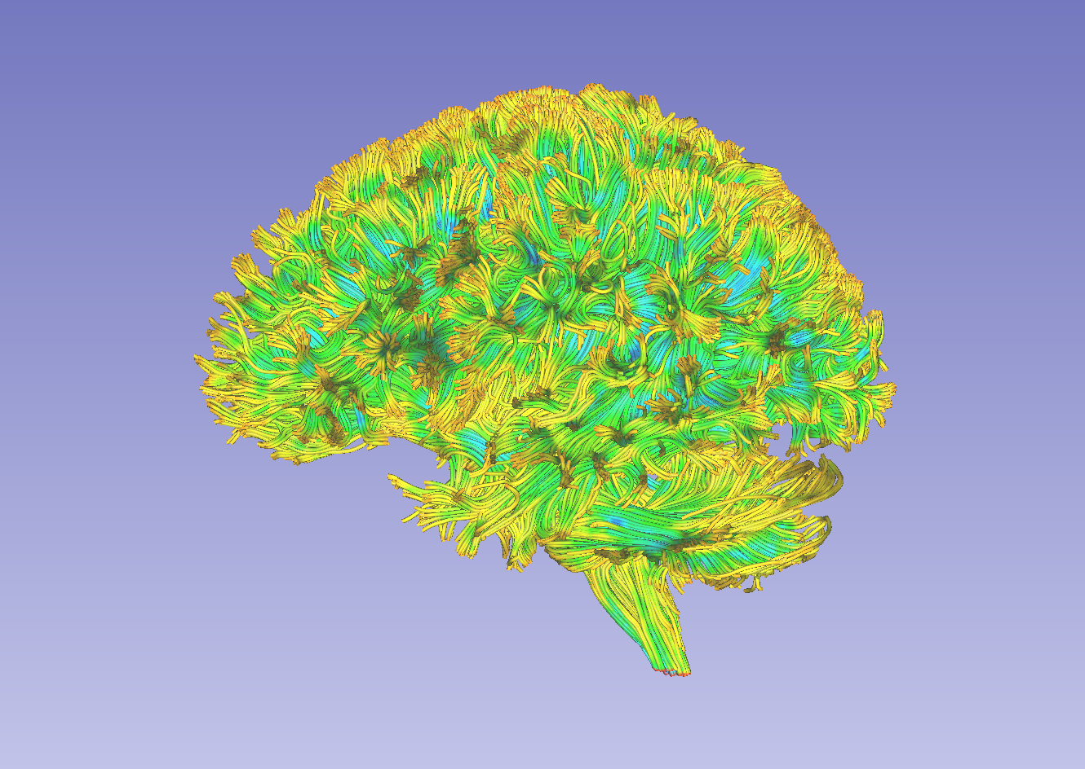
Data preview
CC label on baseline image (from left view)
Whole brain tractography (from left view)
Case 1
Case 2
Case 3
Case 4
Case 5
Notes:
If you go to the Data module, you will see the data just loaded

Slide 11
Shell script
Copy the code here into a file, name it to cli_tutorial_script.sh and put the sh file in the data folder.
# Written by Fan Zhang, fzhang@bwh.harvard.edu, BWH, HMS and USYD
datafolder='.' # . is current folder. User may replace it with the data base path.
slicerpath=/Applications/Slicer.app/Contents # replace it with your local 3D Slicer.
slicerdmripath=$slicerpath/Extensions-26813/SlicerDMRI # Plese note the Extensions ID could be different
# Step 1: fiber bundle selection of CC
fiberbundleselectCLI=$slicerdmripath/lib/Slicer-4.8/cli-modules/FiberBundleLabelSelect
echo "Step 1: Conducting fiber bundle selection"
for vtkfile in `ls $datafolder/case_*_tractography_p.vtk`
do
caseid=${vtkfile:${#vtkfile}-25:6}
wholebraintractography=$datafolder/$caseid\_tractography_p.vtk
CClabelmap=$datafolder/$caseid\_CC_label.nrrd
extractedCC=$datafolder/$caseid\_CC_extracted.vtk
clicommand="$fiberbundleselectCLI $CClabelmap $wholebraintractography $extractedCC -p 1"
echo "#Fiber bundle selection from CC of $caseid"
echo " - Input tractography: $wholebraintractography"
echo " - Input CC label map: $CClabelmap"
echo " - Output CC bundle: $extractedCC"
echo " - CLI command of this process: $clicommand"
$clicommand
done
# Step 2: fiber tract scalar measurement
fiberbundleselectCLI=$slicerdmripath/lib/Slicer-4.8/cli-modules/FiberTractMeasurements
echo "Step 2: Conducting fiber tract scalar measurement"
tractfolder=$datafolder # Use datafolder as input to measure the tractography we just obtained (both whole brain and CC)
measurefile="$datafolder/tractmeasurements.txt"
clicommand="$fiberbundleselectCLI --inputtype Fibers_File_Folder --format Column_Hierarchy --separator Tab --inputdirectory $tractfolder --outputfile $measurefile"
echo "#Scalar measurements from both the whole brain tractography and the extracted CC tracts"
echo " - Input folder: $tractfolder"
echo " - Output measurement: $measurefile"
echo " - CLI command of this process: $clicommand"
$clicommand
echo "Finished!"
Fiber Bundle Selection
Fiber Tract Measurement
Notes:
including the dwi data, dwi_mask file that is brain mask, and b0 image, dti data, fa image. And a fa-label, which is the label map we use to draw the multiple labels form CC. This label map is from the DTI tutorial and it has the entire CC label only. We are going to draw additional labels on it.
And finally, we have a vtk file of CC that is also from the DTI tutorial, we will use this for comparisons later.

Slide 12
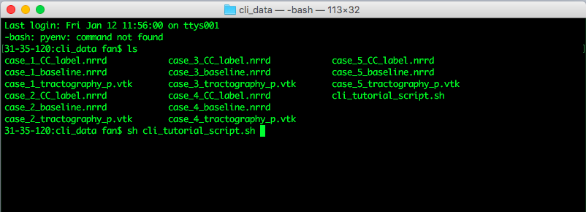
Run script
Open a terminal (The tutorial is based on Mac system: Go to Application -> Utilities -> Terminal.app)
Go to the data folder and view all files provided (ls).
Execute the script (sh cli_tutorial_script.sh)
Notes:
including the dwi data, dwi_mask file that is brain mask, and b0 image, dti data, fa image. And a fa-label, which is the label map we use to draw the multiple labels form CC. This label map is from the DTI tutorial and it has the entire CC label only. We are going to draw additional labels on it.
And finally, we have a vtk file of CC that is also from the DTI tutorial, we will use this for comparisons later.

Slide 13
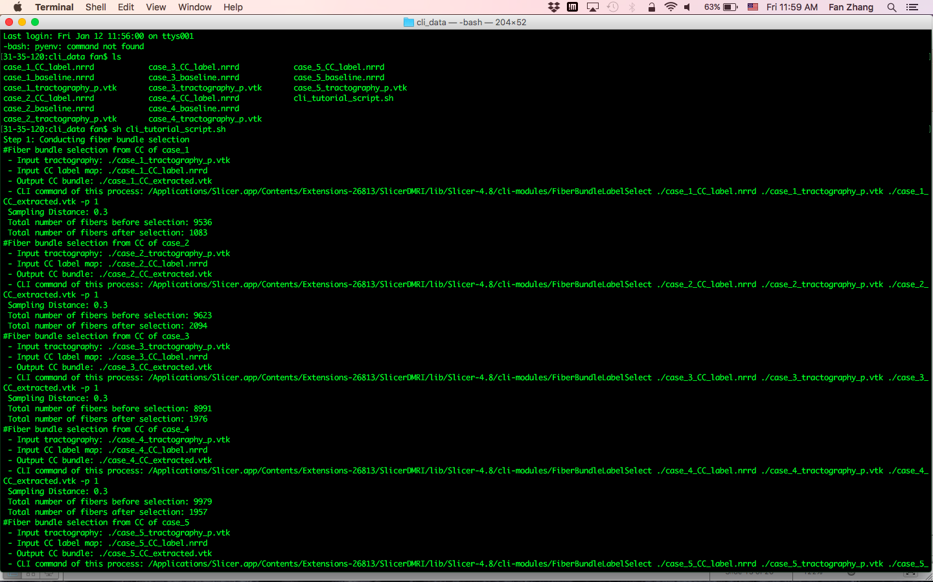
Run script
Script output
Notes:
including the dwi data, dwi_mask file that is brain mask, and b0 image, dti data, fa image. And a fa-label, which is the label map we use to draw the multiple labels form CC. This label map is from the DTI tutorial and it has the entire CC label only. We are going to draw additional labels on it.
And finally, we have a vtk file of CC that is also from the DTI tutorial, we will use this for comparisons later.

Slide 14
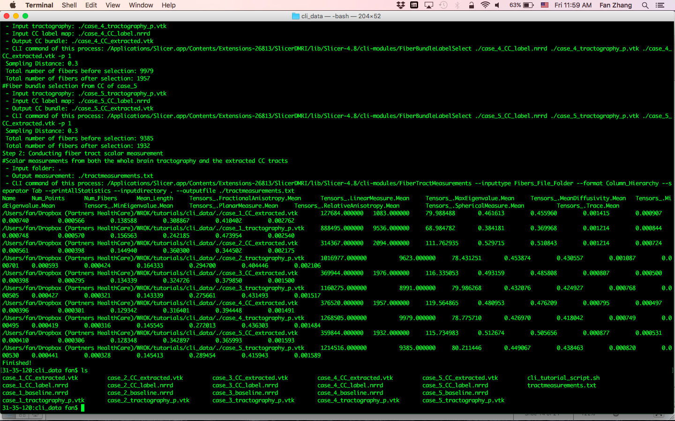
Run script
View all files after the processing (ls)
Notes:
including the dwi data, dwi_mask file that is brain mask, and b0 image, dti data, fa image. And a fa-label, which is the label map we use to draw the multiple labels form CC. This label map is from the DTI tutorial and it has the entire CC label only. We are going to draw additional labels on it.
And finally, we have a vtk file of CC that is also from the DTI tutorial, we will use this for comparisons later.

Slide 15
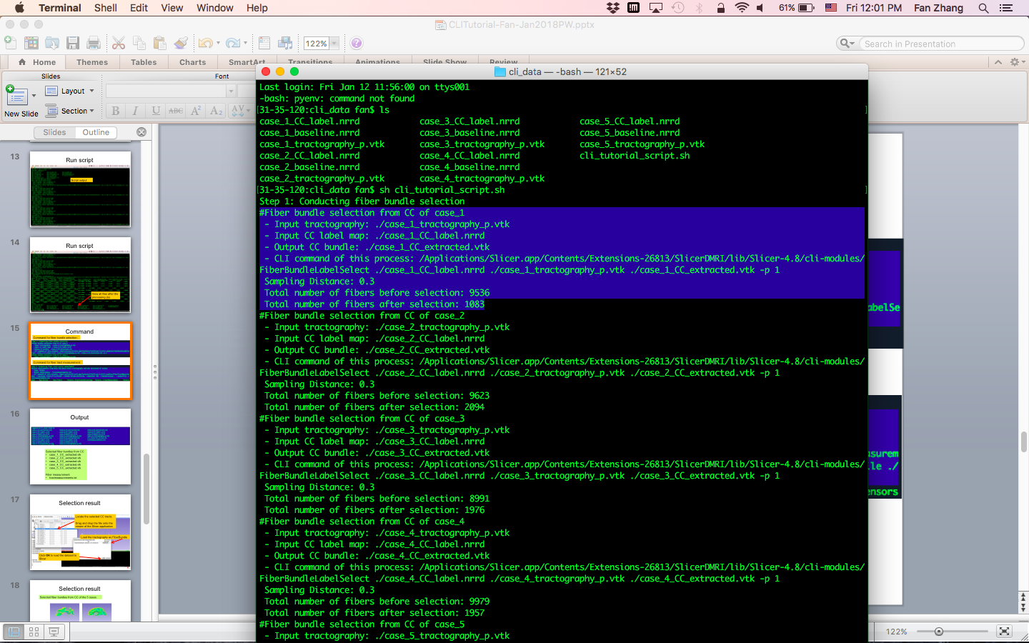
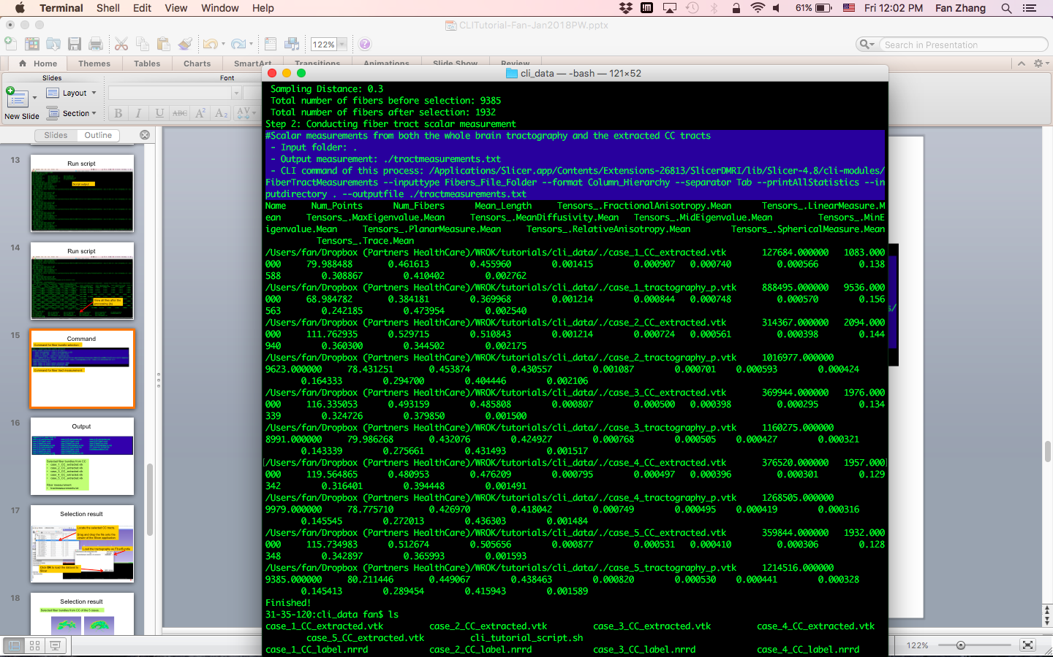
Command
Command for fiber bundle selection:
Command for fiber tract measurement:
Notes:
including the dwi data, dwi_mask file that is brain mask, and b0 image, dti data, fa image. And a fa-label, which is the label map we use to draw the multiple labels form CC. This label map is from the DTI tutorial and it has the entire CC label only. We are going to draw additional labels on it.
And finally, we have a vtk file of CC that is also from the DTI tutorial, we will use this for comparisons later.

Slide 16
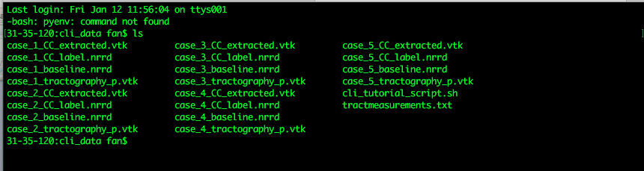
Output
Selected fiber bundles from CC
case_1_CC_extracted.vtk
case_2_CC_extracted.vtk
case_3_CC_extracted.vtk
case_4_CC_extracted.vtk
case_5_CC_extracted.vtk
Fiber measurement:
tractmeasurements.txt
Notes:
including the dwi data, dwi_mask file that is brain mask, and b0 image, dti data, fa image. And a fa-label, which is the label map we use to draw the multiple labels form CC. This label map is from the DTI tutorial and it has the entire CC label only. We are going to draw additional labels on it.
And finally, we have a vtk file of CC that is also from the DTI tutorial, we will use this for comparisons later.

Slide 17
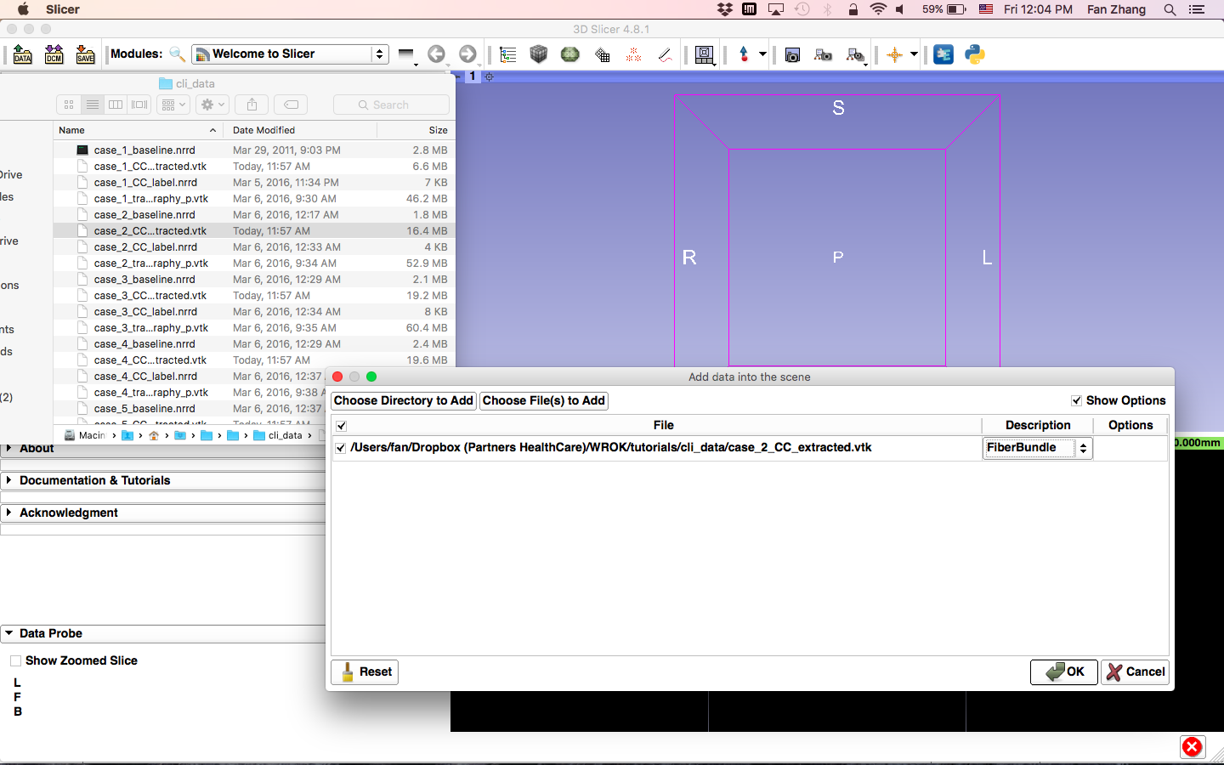
Selection result
Locate the selected CC tracts.
Drag and drop the file onto the viewer of the Slicer application
Load the tractography as FiberBundle
Click OK to load the dataset to Slicer
Notes:
First, let’s load a mrml file that includes the data we need in this tutorial.

Slide 18
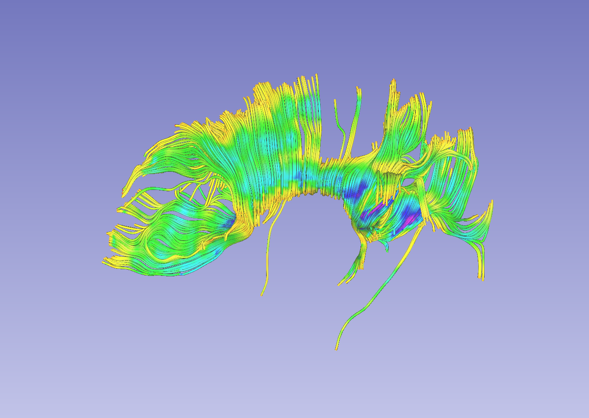
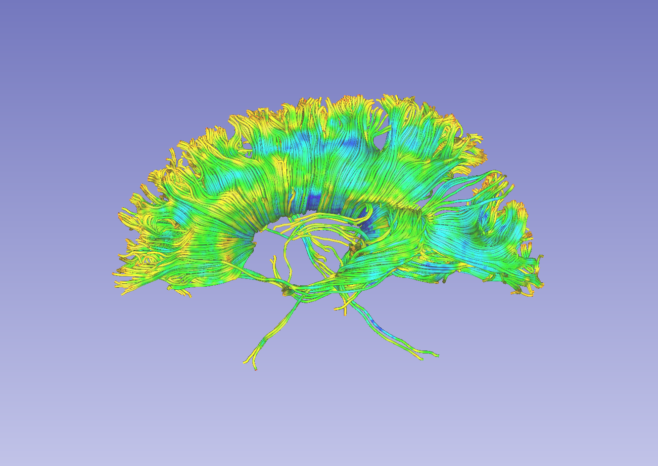
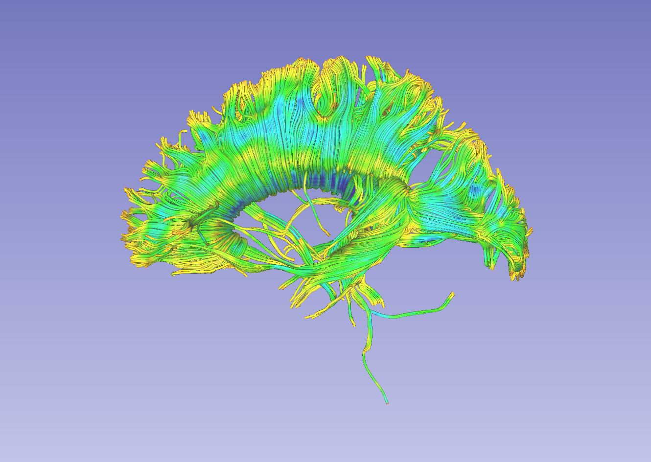
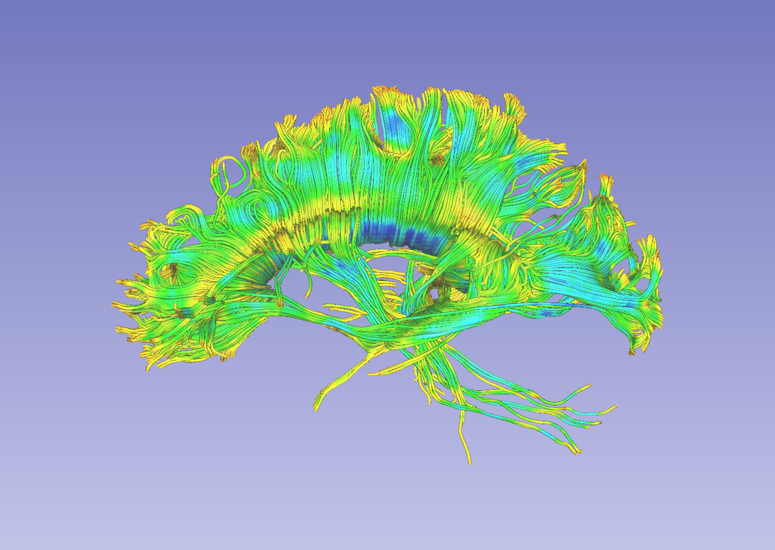
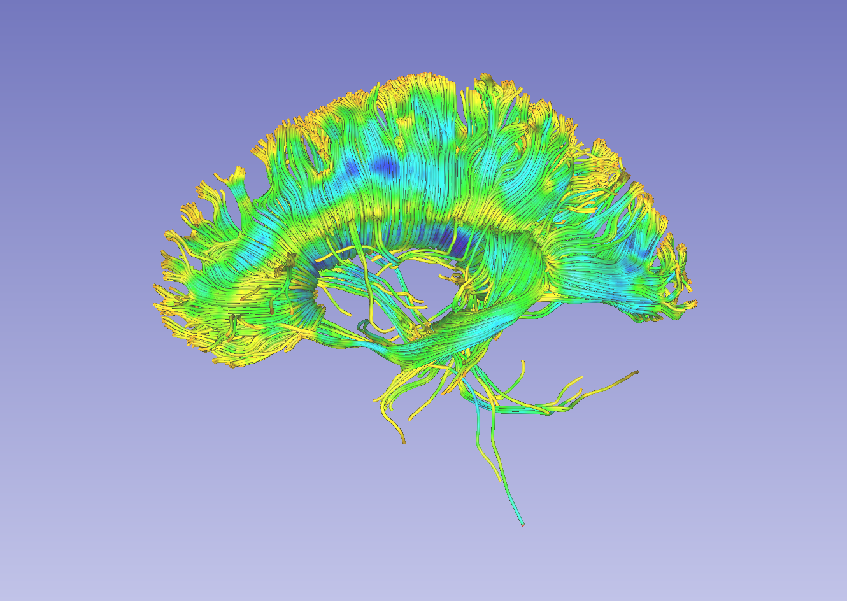
Selection result
Selected fiber bundles from CC of the 5 cases.
Case 1
Case 2
Case 3
Case 4
Case 5
Notes:
First, let’s load a mrml file that includes the data we need in this tutorial.

Slide 19
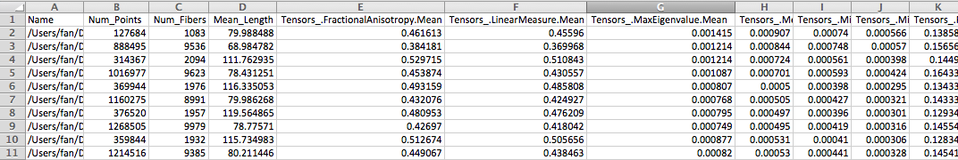
Measurement result
The txt file (tractmeasurements.txt) lists the mean scalar value (such as FA and Trace) of all fiber tracts, including the whole brain tractography and CC fiber bundles.

Slide 20
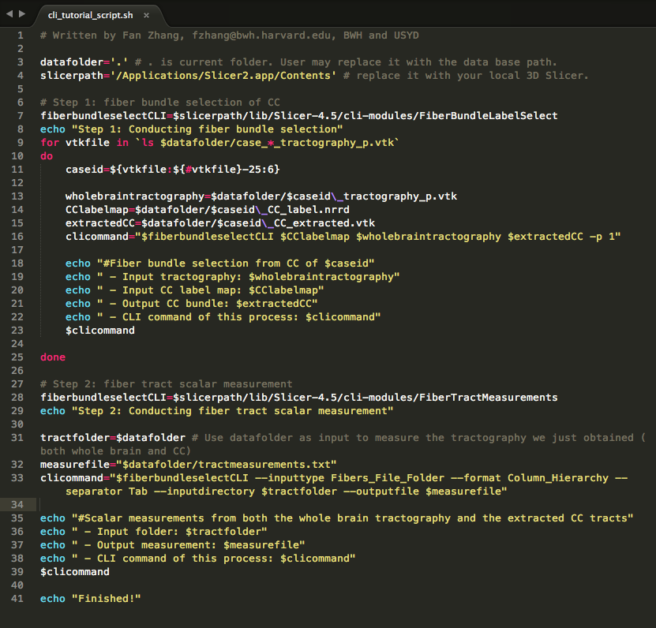
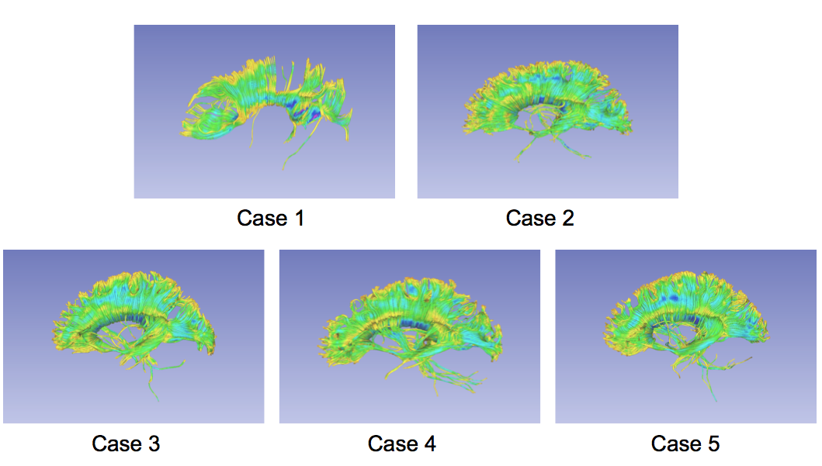
Conclusion
This tutorial guided you through the fiber bundle label selection and fiber tract scalar measurements in the CLI mode.

Slide 21
Acknowledgments
Open Source Diffusion MRI Technology For Brain Cancer Research
NIH U01CA199459
National Center for Image Guided Therapy (NCIGT)
NIH P41EB015898
Neuroimage Analysis Center (NAC)
NIH P41EB015902
The University of Sydney, APA/IPRS/ARC
International Postgraduate Research Scholarships
Australian Postgraduate Award
Australian Research Council

